Slide 1
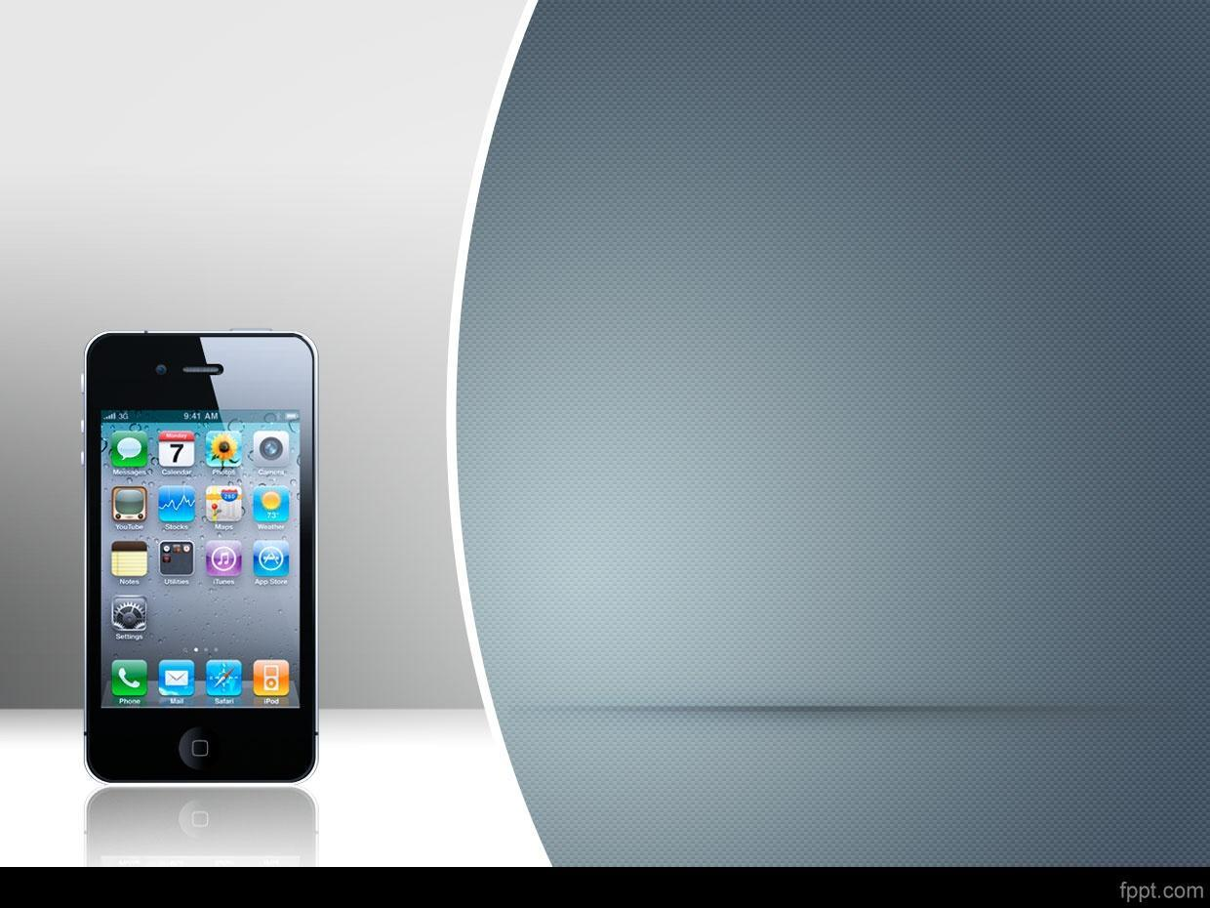
7th Sem Mini Project
Synchronized application for distributed access of mobile devices

Slide 2
Team members
Chigurupati VedaVyas (RIT2010074)
Rahul Sharma (RIT2010061)
Mragank Tolwani (RIT2010072)
Under The Guidance Of
Prof. R.C. Tripathi

Slide 3
Objective
The objective of this project is to develop an application which distributes the access to a mobile devices, directly connected to the system on which it is running, to all those instances of applications which are running on some other systems on the network, priority wise.

Slide 4
Motivation
Scenerio 1:- Consider a scenario where there are multiple mobile software developers working in an organisation. It is quite burdensome for the organisation to buy a mobile for each of its developers.

Slide 5
Scenerio 2:- Consider the Scenerio of the mobile showrooms where it is not a good practice to give the mobile (which may be very costly) to the salesperson for demostrating its features, or to a customer for checkng its features.

Slide 6
Tools and Techniques
Virtual Network Computing :-
It is a graphical desktop sharing system that uses the RFB protocol (remote frame buffer) to remotely control another computer.
It transmits the keyboard and mouse events from one computer to another, relaying the graphical screen updates back in the other direction, over a network.

Slide 7
Android Debug Bridge :- is a tool for Android developers, available for Windows, Linux, and Mac OS X. Found as part of the Android SDK Platform-tools package, it consists of both client and server-side programs that communicate with one another. The ADB is typically accessed through the command-line interface.

Slide 8
Monkey Runner :- The monkey runner tool provides an API for writing programs that control an Android device or emulator from outside of Android code. It sends keystrokes to the device, takes screenshots of its user interface, and stores screenshots on the workstation.

Slide 9
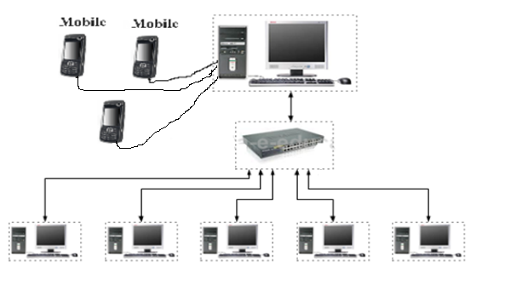
Physical Layout

Slide 10
Proposed Methodology
The application works on the principle of Virtual Network Computing.
In a VNC the client will be sending the keystrokes and other inputs to the host and the host will be relaying the screenshots to the client.

Slide 11
Similarly in this application there is a server computer which will be connected to the mobile device via USB and waits for a client to request a virtual connection with the device.
There is a client application which will take server ip address and port number as input parameters and requests the server for a virtual connection with the mobile device.

Slide 12
When the server receives a request from a client, it determines the ip address of the client and assigns a port number(on the server computer) to it for communication with that particular host. Client is then added to wait queue.
Various clients which are in the wait queue are granted the virtual connection with the mobile device based on the round robin (time sliced) scheduling method.

Slide 13
When any client disconnect then the port allocated to that particular client is freed and the client is removed from the wait-queue.

Slide 14


Slide 15
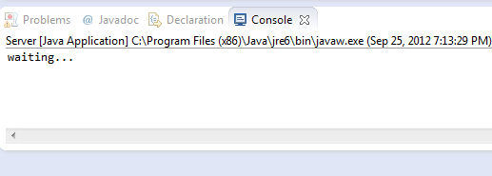
Step 1:- Start the Server Process

Slide 16
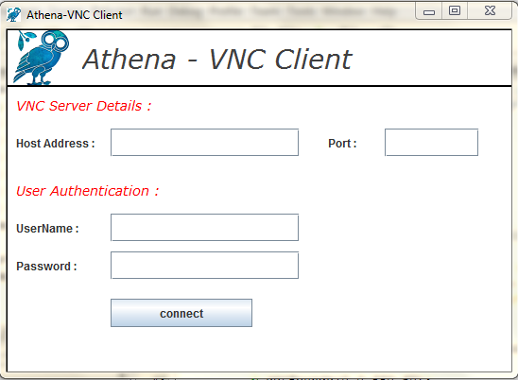
Step 2:- Start the Client Process

Slide 17
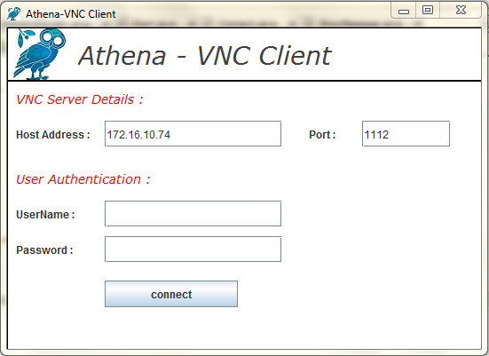
Step 3:- Provide Server IP and port

Slide 18
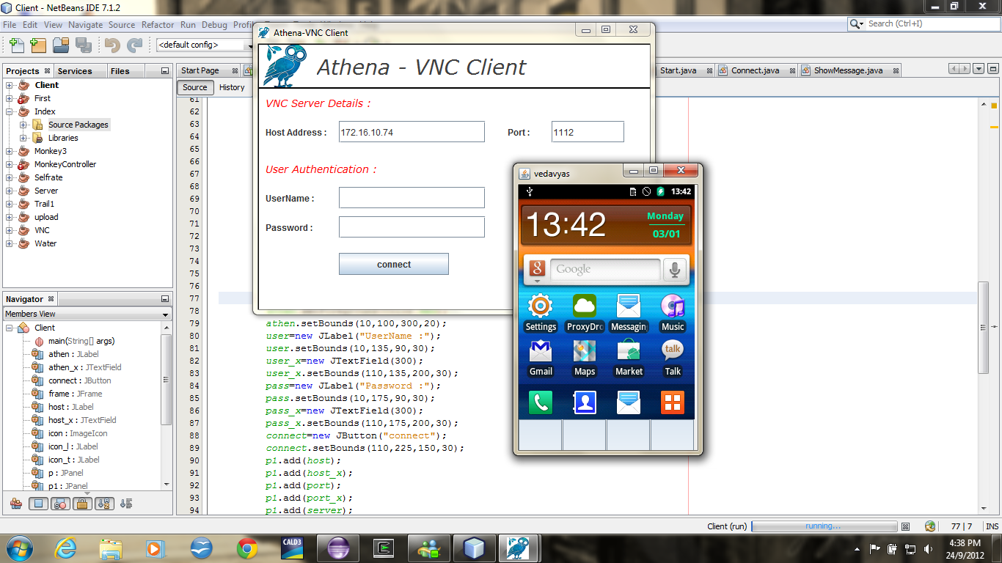
Step 4:-Server sends the initial screenshot of phone to client

Slide 19
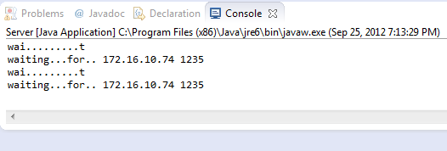
Step 5:-Server Waiting for Mouse or keyboard inputs :-

Slide 20
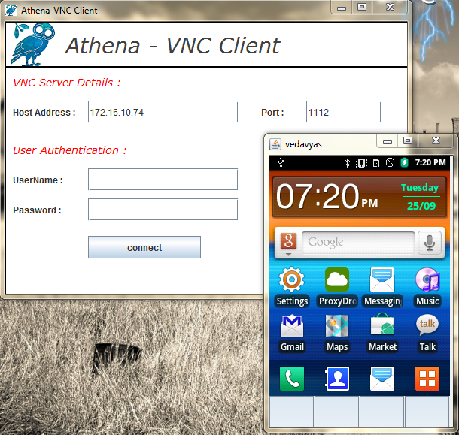
Step 6:- Send Mouse or key Board Strokes:-

Slide 21
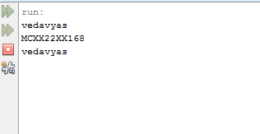
Step 7:- Server Receives the input,decodes it and executes it on the mobile device.

Slide 22
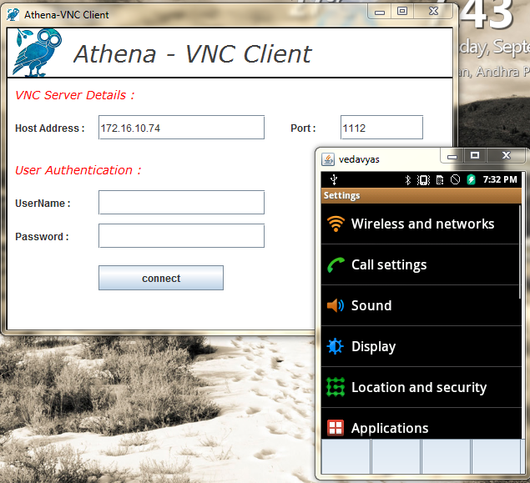
Step 8 :- Iterate to step 1 :-
Frame repainted in the client.

Slide 23
Features:-
Provides Time Sliced access to Mobile device virtually.
Requires no app to be installed in the mobile.
Doesnt require the mobile to be rooted or the application will never ask for the Super User privilages.

Slide 24
Work-Done Till Mid-Sem:-
Client Side Application :-
Receiving the ScreenShots from the server and Repainting the frame.
Reading the Mouse and Key Board inputs, encoding then and sending then to the Server.

Slide 25
Server Side Application :-
Connecting with the mobile device.
Getting the Screen Images from the mobile device.
Transferring the Screen Images to Client.
Receiving the inputs from Client, decoding then and Executing then on the device.
Can serve only one Client.

Slide 26
Post Mid-Sem work:
Server Application will be developed further to catter the access of the mobile device via HTTP
Multi user Scheduling
Security and performance enhancement

Slide 27
References
Books & Monographs:
Vijay.k.Garg, Elements of Distributed Computing: John Wiley & Sons,2002
Shane Conder ,Android Wireless Application Development:Pearson,2009
Android Application Development :O’Reilly
On-line open literature & Internet:
http://developer.android.com/tools/support-library/features.html (Accessed: 25 September 2013)
http://developer.android.com/tools/help/monkeyrunner_concepts.html (Accessed: 21 September 2013)
http://heather.cs.ucdavis.edu/~matloff/vnc.html (Accessed: 9 September 2013)

